Slide 1
Lesson objective
Title: Index notation
Aim:
Expand and simplify indices
Apply index laws to numerical expressions
Plan:
Reteach
Indices
Exploring laws
Need whiteboards.

Slide 2
Indices
Repeated addition is the same as multiplication
5 + 5 + 5 + 5 + 5 + 5 = 30
Same as: 5 x 6 = 30
Repeated multiplication is where indices come in.
4 x 4 x 4 = $4^{3}$
8 x 8 x 8 x 8 x 8 = $8^{5}$
6 x 6 x 6 x 6 x 6 x 6 x 6 x 6 = $6^{?}$
This is a lot easier and takes less room… it’s the “simplified” version.

Slide 3
Example
Simplifying multiplication.
2 x 2 x 2 x 2 = $2^{4}$
9 x 9 x 9 = $9^{3}$
10 x 10 x 10 x 10 x 10 x 10 x 10 = ${10}^{?}$
Index number (number of repeats for base number)
$$8^{4}$$
Base number (number being multiplied)
Expanded form
Simplified form

Slide 4
Whiteboards
Simplify:
2 x 2 x 2 x 2 x 2
8 x 8 x 8 x 8
12 x 12 x 12
3 x 3 x 3 x 3 x 3 x 3

Slide 5
Whiteboards
Expand:
$6^{3}$
$9^{5}$
$3^{2}$

Slide 6
Index Laws
How can I simplify: 4⁵ x 4³?
How can I simplify: 7⁹ x 7⁶?
4 x 4 x 4 x 4 x 4
x
= 4⁸
4 x 4 x 4
7 x 7 x 7 x 7 x 7 x 7 x 7
x
= 7¹⁵
7 x 7 x 7 x 7 x 7 x 7
What pattern do we notice about the pattern of the index number?

Slide 7
Law 1 : Multiplication
2⁶ x 2⁴
= 2¹⁰
2⁴ x 2²
= 2⁶
3⁵ x 3⁷
= 3¹²
General Rule:
When multiplying terms with the same base, you add the indices
a^{m} x a^{n} = a^{m+n}
EXAMPLE: 4⁷ x 4⁵ = 4⁷⁺⁵ = 4¹²

Slide 8
Index Laws
How can I simplify 9⁵ ÷ 9³?
How can I simplify 11⁷ ÷ 11²?
9 x 9 x 9 x 9 x 9
= 9 x 9 = 9²
9 x 9 x 9
11 x 11 x 11 x 11 x 11 x 11 x 11
= 11⁵
11 x 11
What pattern do we notice about the pattern of the index number?

Slide 9
Law 2 : Division
2⁶ ÷ 2⁴
= 2²
2⁵ ÷ 2²
= 2³
3⁵ ÷ 3⁷
= 3⁻²
General Rule
When dividing terms with the same base, you subtract the indices
a^{m} ÷ a^{n} = a^{m-n}
EXAMPLE: 4⁷ ÷ 4⁵ = 4⁷⁻⁵ = 4²

Slide 10
Index Laws
How can I simplify (4³)⁴?
How can I simplify (7²)⁵?
4 x 4 x 4
x
4 x 4 x 4
x
4 x 4 x 4
x
4 x 4 x 4
= 4¹²
7 x 7
x
7 x 7
x
7 x 7
x
7 x 7
x
7 x 7
= 7¹⁰
What pattern do we notice about the pattern of the index number?

Slide 11
Law 3 : Brackets
(2⁶)²
= 2⁶ x 2⁶
= 2¹²
(3⁵)³
= 3⁵ x 3⁵ x 3⁵
= 3¹⁵
General Rule:
When raising a power to another power, you multiply the powers
(a^{m})^{n} = a^{m x n}
EXAMPLE: (4⁷)⁵= 4⁷ ^{x} ⁵ = 4³⁵

Slide 12
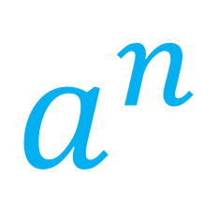
NOTES
a^{m} x a^{n} = a^{m+n}
a^{m} ÷ a^{n} = a^{m-n}
(a^{m})^{n} = a^{m x n}
INDEX is the number of times the base is involved in repeated multiplication
$$a^{n}$$
BASE is the letter or number being used in repeated multiplication

Slide 13
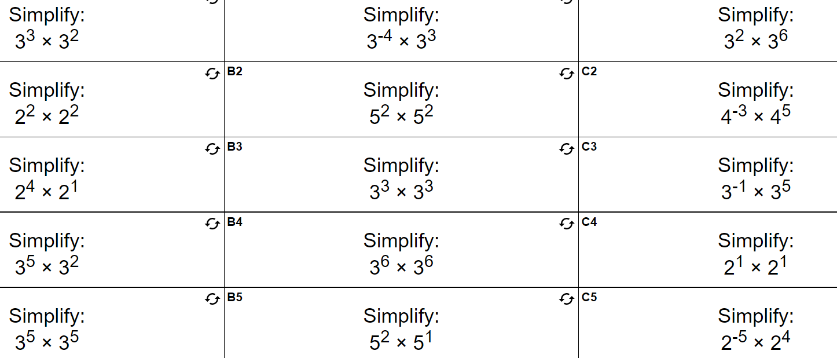
Index Laws

Slide 14
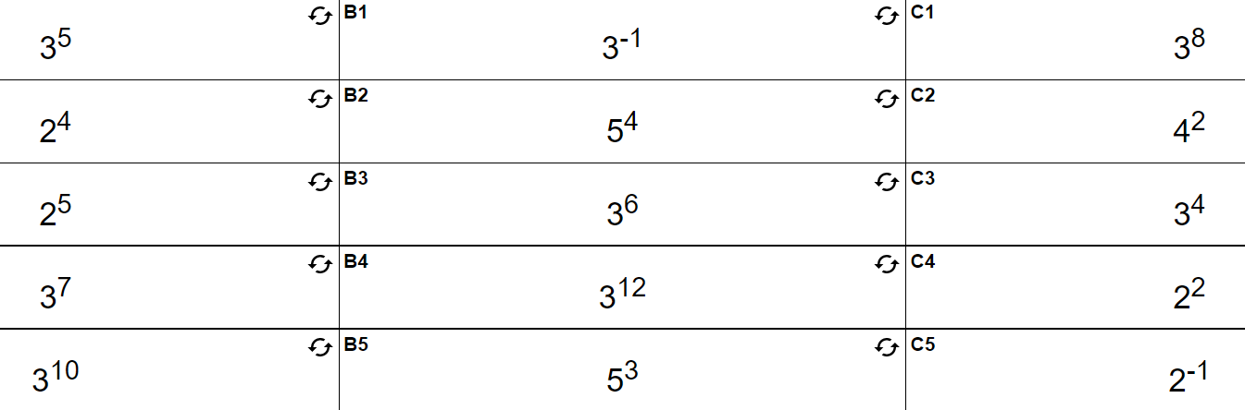
Answers

Slide 15
Reflection
Aim:
Expand and simplify indices
Apply index laws to numerical expressions

